Slide 1
Arc Face: Additive Angular Margin Loss for Deep Face Recognition
An Advanced Facial Recognition Algorithm
BY
Murali Krishna Kancheti Gayatri Ravada

Slide 2
Overview of Facial Recognition Technology
Facial recognition technology is a biometric technology that involves the identification or verification of individuals based on their unique facial features.
For instance, Biometric identification, it is a biometric identification method that analyze and measure unique characteristics of person’s face such as distance between eyes, nose shape, and jawline, are used to create a facial template or signature
Feature extraction: this algorithm extract distinctive features from the facial image, converting them into data points or vectors.
Database comparison: the extracted facial features are compared to the pre- existing templates or data stored in a database.
Applications: security and access control (airports, government facilities), Law Enforcement (public surveillance), mobile devices, attendance tracking, etc.

Slide 3
Feature Embeddings
A typical CNN for classification consists of feature extraction and classification. During training, the model learns the unique facial features and produces feature embeddings in the feature extraction process. Once the training is complete, you can skip the classification part and produce feature embedding for each face image, which is like a digital “fingerprint”. Another way to think about embedding vector is like a conversion of high dimensional data to a relatively low dimension

Slide 4
SoftMax vs ArcFace
In a standard classification network, SoftMax and Categorical Cross-Entropy loss are usually used at the end of the network. SoftMax transforms numbers into probabilities. For each object, it gives a probability for each class that sums to 1. Once training is complete, the class with the highest probability is chosen. The Categorical Cross-Entropy loss calculates the difference between two distributions of probabilities and is minimized in the process of back-propagation during the training.

Slide 5
Drawbacks with the Traditional Method
The drawback with SoftMax is that it does not produce a safety margin, which means that the borders are a bit blurry. We want the vectors of two images of the same person to be as similar as possible, and the vectors of two images of two different people to be as different as possible. That means we want to produce a margin, as SVM does.

Slide 6
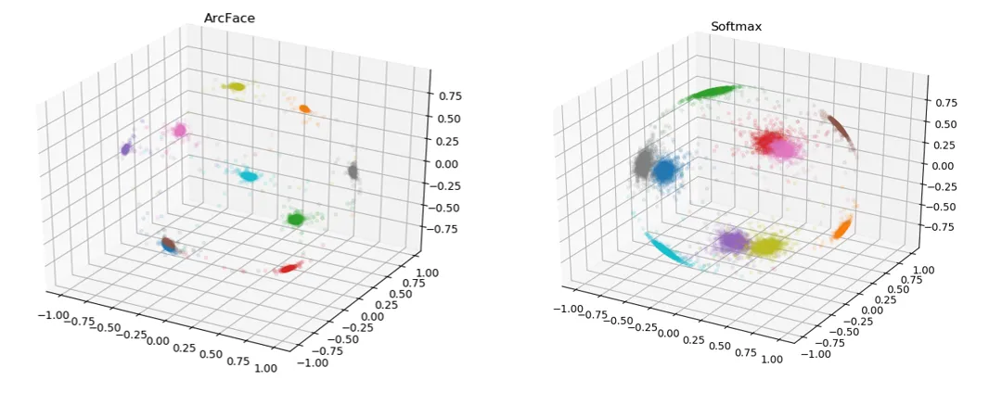
Look at the example below. Here, we see feature embeddings of MNIST digits. It is noticeable that the boundaries of SoftMax features are relatively blurred compared to Arcface feature embeddings

Slide 7
Motivation to ArcFace
Challenges in traditional face recognition:
Traditional methods can struggle to handle variations in lighting conditions, making it challenging to accurately recognize faces in different levels of illumination.
Changes in facial pose (such as sitting or turning the face) can significantly impact the performance of traditional face recognition systems, leading to lower accuracy.
Expressions like smiling, frowning, or squinting can introduce variability in facial features. Traditional methods may struggle to robustly recognize faces across different expressions.
When parts of the face are obscured or partially hidden, such as sunglasses, hats or facial hair, traditional systems may fail to accurately identify individual
Traditional face recognition may not be robust to changes in facial appearance due to aging , weight loss or gain, or other time- dependent factors.
Traditional softmax loss functions used for classification may not effectively capture subtle differences between faces, resulting in limited discrimination ability, especially in scenarios with a large number of classes.

Slide 8
ArcFace and its significance
It is a machine learning model that can be used for face recognition and face search.
It takes two face images as input and outputs the distance between them. The distance indicated how likely the images are to be of the same person.
It is also known as Additive Angular Margin Loss. it’s a loss function that’s used in face recognition tasks.
It maximizes the margin, which is the decision boundary at the geodesic space on the hypersphere. This is achieved through normalized weights and features.
It has a constant linear angular margin throughout the whole interval.
It addresses challenges in traditional softmax loss functions used for face recognition.

Slide 9
Advantages
Angular Margin Enhancement: ArcFace introduces an angular margin to the traditional softmax loss function, which helps in better discrimination between different identity classes.
Robustness to variations: it is known for its robustness to variations in lighting, pose and facial expressions. It is more reliable in real- world scenarios.
Large- scale Face Recognition: it is particularly effective in large- scale face recognition scenarios where there are a vast number of identities to be recognized.
Feature normalization: this technique helps in maintaining consistent performance across different faces and minimizing the impact of variations in facial appearance.
Face verification performance: it achieves better accuracy by optimizing the feature space for face recognition tasks.
Open- source implementation: the open- source implementation of ArcFace available, making it accessible to researchers, and developers who want to experiment with or incorporate facial recognition capabilities into their application.

Slide 10
Angular margin and its significance
The concept of angular margin is a key component of algorithms like ArcFace in facial recognition.
Key points:
The angular margin is a mathematical parameter introduced in the loss function of facial recognition algorithms, such as ArcFace.
The angular margin effectively expands the embedding space between classes, creating a more distinct and separable features representation for each identity.
With the introduction of an angular margin, the algorithm learn to generate feature embeddings that are more representative of the unique characteristics of each individual.
The angular margin improves the robustness of the facial recognition algorithms to variations in lighting, pose, and facial expressions.
The angular margin contributes to improved generalized capability, allowing the algorithm to perform well on diverse datasets and under various real- world conditions.

Slide 11
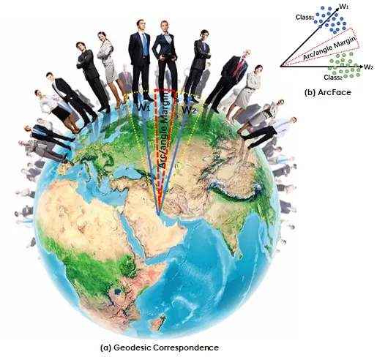

Slide 12
How arc face works?
ArcFace is an advanced facial recognition algorithm that improves upon traditional methods by introducing an angular margin in the loss function.
This margin enhances the discrimination between different individuals, thereby creating distinct feature embeddings.
During the training process, ArcFace optimizes the feature space for face recognition by emphasizing the significance of angular margins.
The algorithm utilizes an end-to-end training approach that ensures joint optimization of feature extraction and classification layers.
This results in a facial recognition system that is highly accurate and robust in large-scale scenarios, less sensitive to variations in lighting and pose, and has demonstrated state-of-the-art performance in benchmarks.

Slide 13
Feature Extraction and Normalization
The ArcFace algorithm captures unique facial characteristics from input images through feature extraction. This process creates feature embeddings that emphasize the angular margin, enhancing discrimination between different individuals. The algorithm uses an end-to-end training approach, optimizing both feature extraction and classification layers for accurate face recognition.
Feature normalization is a crucial step in ArcFace that ensures consistent performance across different faces. By normalizing the extracted features, the algorithm minimizes the impact of variations in facial appearance, such as lighting and pose. This normalization process contributes to the algorithm's robustness, making it reliable in diverse real-world scenarios. Together, feature extraction and normalization in ArcFace form a powerful combination, allowing for precise and efficient face recognition.

Slide 14
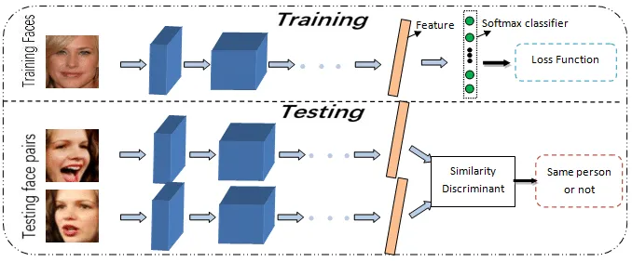

Slide 15
Privacy Protection in Facial Recognition: With the increasing use of facial recognition technology, concerns about privacy have become paramount.
Non-invertible Models: The paper proposes a future direction to explore making face recognition models non-invertible to prevent easy reconstruction of face images from model weights.
Importance of Privacy: Emphasize the critical need to balance the benefits of facial recognition with protecting individual privacy.

Slide 16
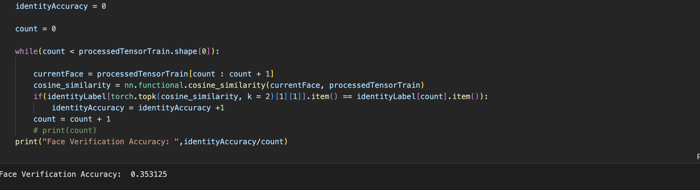
Performance and results
Trained the model with pre weights using ir_50 back bone architecture and tested it with the data set available at https://www.kaggle.com/datasets/rajiinio/celebset . This is improved when trained on GPU and TPU with different batch data sizes.

Slide 17
Privacy Enhancement with Hash Layer
To assess the effectiveness of the added hash layer in preserving privacy, we measured the information leakage and compared it with the baseline ArcFace without the hash layer.
Baseline ArcFace: Potential information leakage observed during model inversion.
ArcFace with Hash Layer: Marked reduction in information leakage, demonstrating its efficacy in enhancing the privacy of face embeddings.

Slide 18
Applications
Security and Access Control
Law Enforcement and Surveillance
Retail Analytics
Attendance Tracking
Border Control and Immigration
Mobile Device Security
Healthcare Access Control
Smart Cities

Slide 19
Future development
Privacy Concerns and Future Work
Addressing Privacy Concerns: unauthorized image reconstruction using image inverting
Future Work Overview: enhance privacy in face recognition models.

Slide 20
Approach to Protect Privacy
Feature Extraction and Hashing:
Transition from Raw Images: Move away from storing raw face images to extracting relevant features.
Improved Privacy: Feature extraction ensures that only essential facial information is retained.
Hashing Process: The extracted features are then hashed to add an additional layer of security.
One-Way Hash Functions:
Introduction: Implement one-way hash functions to protect against reconstruction.
Irreversibility: One-way hash functions make it challenging to reverse the process and reconstruct the original input.
Privacy Enhancement: This technique ensures that even if the model is compromised, the original facial features remain protected

Slide 21
Proposed Algorithm - Adding Hashing Layer
Cryptographic Hash Function:
Introduction: Incorporate a cryptographic hash function as a new layer in the model architecture.
Purpose: The hash function transforms facial embeddings into hash codes, enhancing the security of stored information.
Strength of Encryption: Highlight that the cryptographic hash function is selected for its robust security features.
Transformation of Embeddings:
Process Overview: hash layer transforms facial embeddings into hash codes.
Irreversibility: This transformation ensures irreversibility, making it difficult to reconstruct the original facial features.
Ensuring Security:
Importance of Security: secure cryptographic hash function is crucial for the overall effectiveness of the privacy protection approach.
Mitigating Risks: Hash layer mitigates risks associated with potential attacks, safeguarding both data and model integrity.

Slide 22
Benefits of Hashing Layer
Enhanced Privacy:
Added Layer of Protection: The Hashing Layer introduces an extra level of security, enhancing overall privacy.
Minimizing Risks: Reduces the risk of unauthorized access and image reconstruction.
Robust against Reconstruction Attacks:
Mitigating Risks: The hashing layer significantly reduces the risks associated with potential model weight inversion attacks.
Preserving Facial Features: Despite security measures, the model retains the ability to effectively recognize faces.
Preserving Model Utility:
User-Friendly Recognition: Despite heightened privacy measures, the model maintains its effectiveness in recognizing faces.

Slide 23
Conclusion
As a notable improvement, we have introduced a hash layer to convert embeddings into hash codes, enhancing the privacy of the face recognition system. This addition ensures that sensitive facial information is further protected, adding a crucial layer of security in scenarios where privacy is a paramount concern.
In summary, our work not only pushes the boundaries of face recognition performance but also addresses privacy concerns through innovations such as sub-center ArcFace and the integration of a hash layer. We believe these advancements contribute significantly to the ongoing development of robust and privacy-conscious face recognition systems.

Slide 24
THANKS

